Slide 1
Parallelization of Sparse Coding & Dictionary Learning
University of Colorado Denver
Parallel Distributed System
Fall 2016
Huynh Manh

Slide 2
Recap::K-SVD algorithm
Initialize
D
D
Sparse Coding
Use MP
T
T
X
$$α$$
Dictionary Update
Column-by-Column by SVD computation

Slide 3
Matching Pursuit Algorithms
P
K
P
X
D
X
≈
N
$$α$$
≈
A
K
Each example is a linear combination of atoms from D
Each example has a sparse representation with no more than L atoms

Slide 4
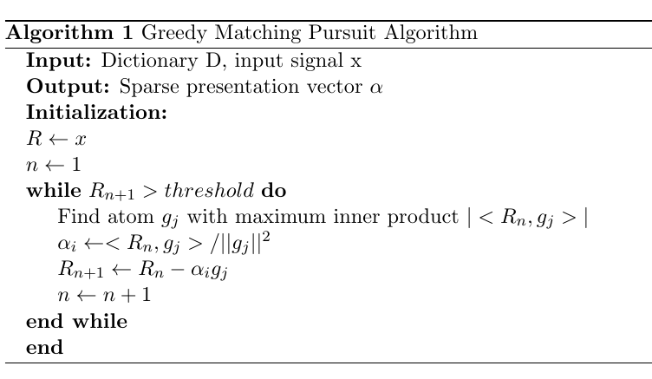
Matching Pursuit Algorithms

Slide 5
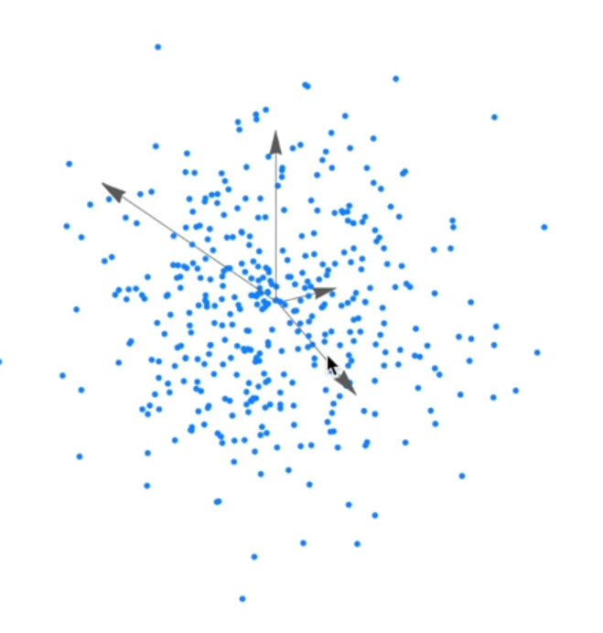
K-SVD algorithm
Here is three-dimensional data set,
spanned by over-complete dictionary of
four vectors.
What we want is to update each of these
vector to better represent the data.

Slide 6
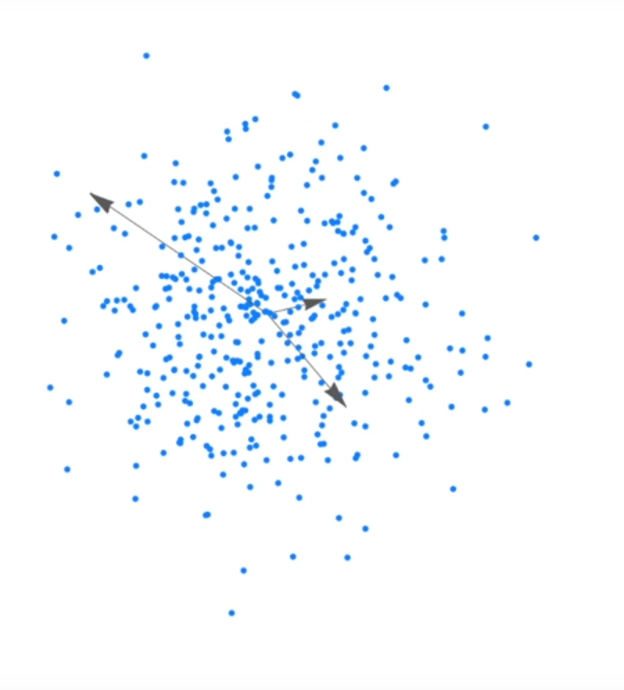
K-SVD algorithm
1. Remove one of these vector
If we do sparse coding using only three
vectors, from the dictionary, we cannot
perfectly represent the data.

Slide 7
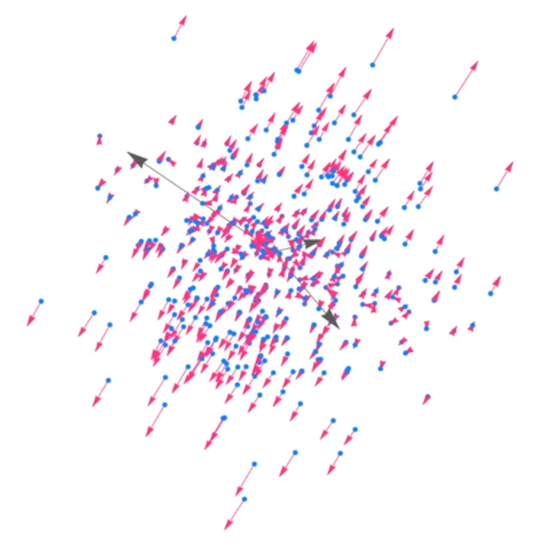
K-SVD algorithm
2. Find approximation error on each data point

Slide 8
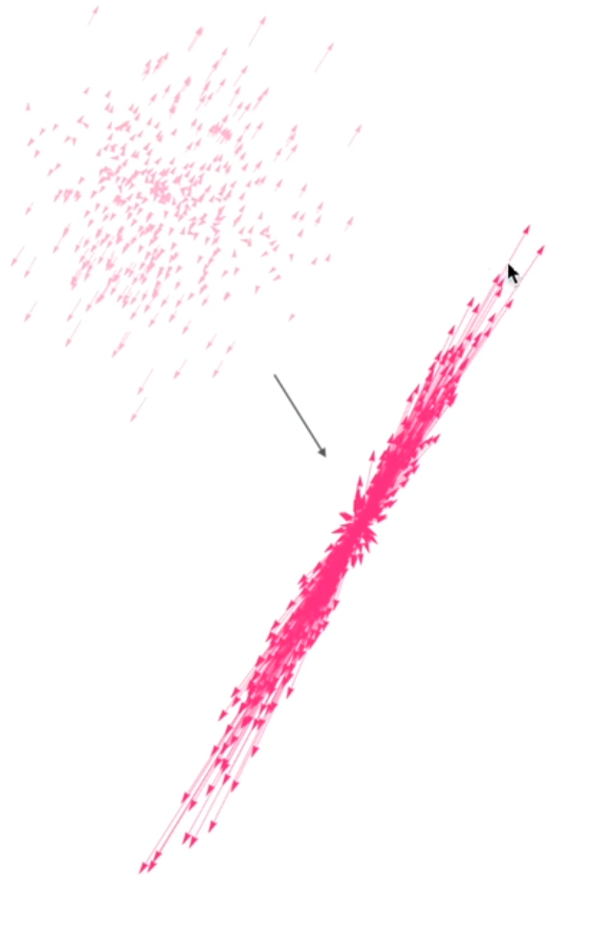
K-SVD algorithm
2. Find approximation error on each data point

Slide 9
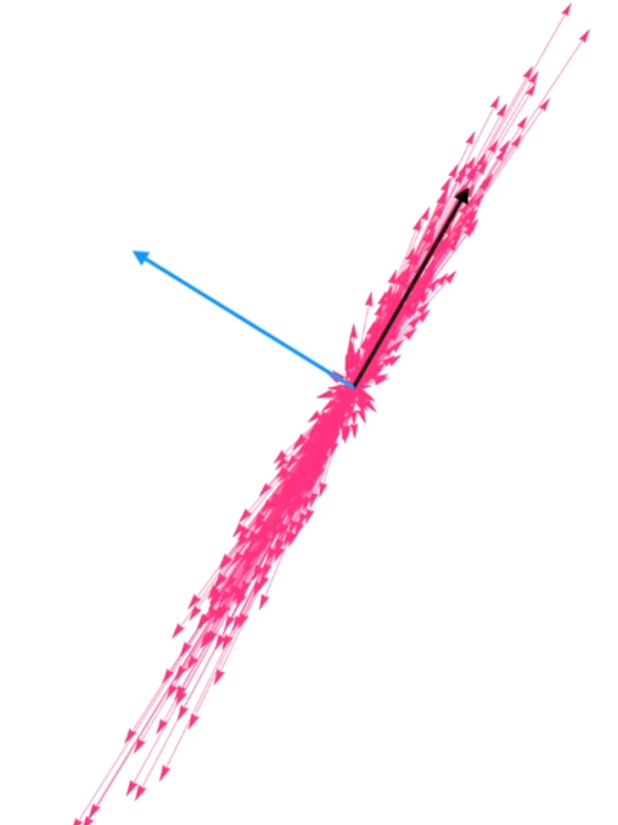
K-SVD algorithm
3. Apply SVD on error matrix
The SVD provides us a set of orthogonal
basis vector sorted in order of decreasing
ability to represent the variance error matrix.

Slide 10
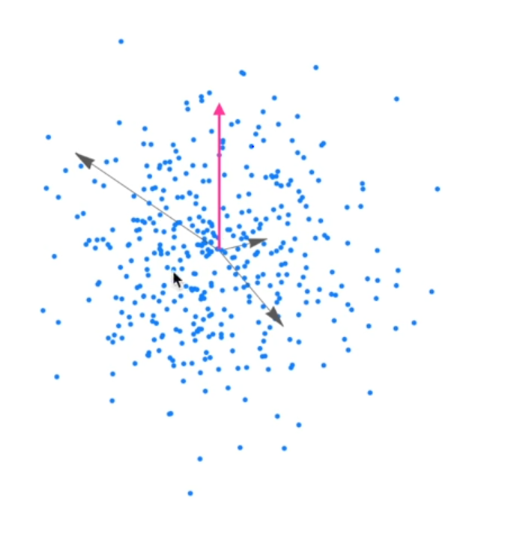
K-SVD algorithm
3. Replace the chosen vector with the
first eigenvector of error matrix.
4. Do the same for other vectors.

Slide 11
K-SVD algorithm
1. Initialize the dictionary randomly
2. Using any pursuit algorithm to find a sparse coding $α,$ for
the input data X using dictionary D.
3. Update D:
a. Remove a basis vector $d_{k}$
b. Compute the approximation error $E_{k}$ on data points
that were actually using $d_{k}$
c. Take SVD of $E_{k}$
d. Update $d_{k}$.
4. Repeat to step 2 until convergence.

Slide 12
Content
Tracking framework
Feature extraction
Singular Decomposition Value (SVD)
Serial implementation.
GPU implementation and comparisons.
A summary
Next work

Slide 13
Multi-target Tracking
Feature Extraction
Video Sequence
Linear motion
Motion Affinity
Final Affinity
Appearance
Hungarian Algorithm
Human Detection Bounding Box
Sparse Coding
(Appearance Affinity)
+
Assignment Matrix
Tracking Results
Spatial information (x,y)
Dictionary Learning
+
Concatenation operator

Slide 14
Multi-target Tracking
Feature Extraction
Video Sequence
Linear motion
Motion Affinity
Final Affinity
Appearance
Hungarian Algorithm
Human Detection Bounding Box
Sparse Coding
(Appearance Affinity)
+
Assignment Matrix
Tracking Results
Spatial information (x,y)
Dictionary Learning
+
Concatenation operator

Slide 15
Feature Extraction
Calculating Color Histogram on upper half and bottom half separately.
R:[nbins x 1]
G:[nbins x1]
B:[nbins x1]
All feature channels are concatenated : [6*nbins x 1]
Spatial location (x,y): [2x1]
Overall, feature size = [(6*nbins + 2) x 1]
If nbins = 1, feature size = [8x1]
If nbins = 255, feature size = [1534 x 1]
R: [nbins x1]
G:[nbins x1]
B:[nbins x 1]

Slide 16
K-SVD algorithm
3. Apply SVD on error matrix
We want to replace a atom with the principal
component that has the most variance.

Slide 17
Principal Component Analysis (PCA) Change of basis
PCA asks: “Is there another basis, which is a linear combination of the original basis, that best re-express our data set ? “
Let $X$ and $Y$ be $m x n$ matrices related by a linear transformation P
$PX=Y$
P is a rotation and a stretch which transform X into Y.
Then, rows of P, $\left\{p_{1}, …., p_{m}\right\}$ are a set of new basis vectors for X

Slide 18
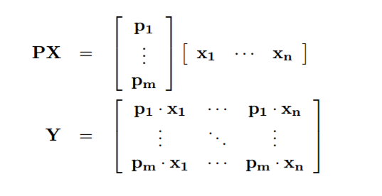
Principal Component Analysis (PCA) Change of basis
Then, rows of linear transformation matrix P, $\left\{p_{1}, …., p_{m}\right\}$ are a set of new basis vectors (important)
Each coefficient of $y_{i}$ is a dot product of $x_{i}$ with the corresponding row in P

Slide 19
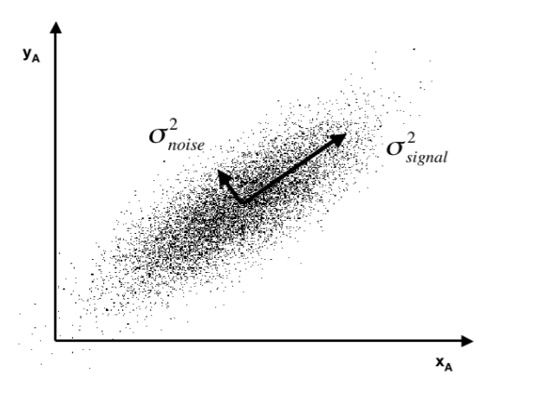
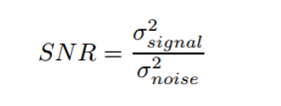
Principal Component Analysis (PCA) The goal
Reducing noise

Slide 20
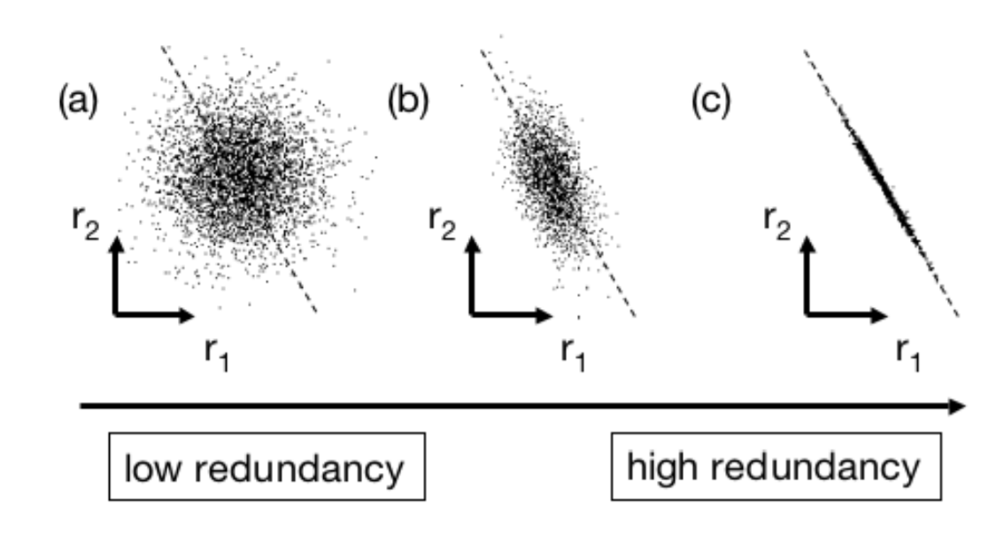
Principal Component Analysis (PCA) The goal
Reducing redundancy

Slide 21
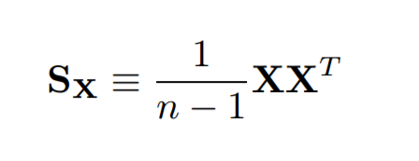
Principal Component Analysis (PCA) The goal
We would like each variable to co-vary as little as possible with other variables.
Diagonalize covariance matrix $S_{x}$ of X. (assumes X is zero-mean matrix)

Slide 22
Principal Component Analysis (PCA) How to find principal component of X ?
Find an orthonormal linear transformation P where $Y=PX$such that $S_{Y}=\frac{1}{n−1 } YY^{T}$ is diagonalized.
Remember that , rows of linear transformation matrix P, $\left\{p_{1}, …., p_{m}\right\}$ are a set of new basis vectors. (previous slide)
=> rows of P are the principal components of X

Slide 23
Principal Component Analysis (PCA) How to find principal component of X ? Solution 1
Theorem: A symmetric matrix is diagonalized by a matrix of its orthogonal eigenvectors. Proof: [3]
If $A=XX^{T}$ so A is a symmetric matrix and
$A=EDE^{T}$
Where:
E is a matrix of eigenvectors
D is a diagonal matrix.

Slide 24
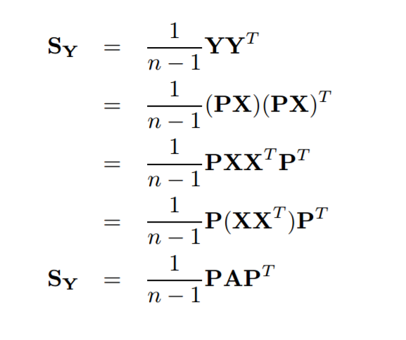
Principal Component Analysis (PCA) How to find principal component of X ? Solution 1
Find an orthonormal linear transformation P where $Y=PX$such that $S_{Y}=\frac{1}{n−1 } YY^{T}$ is diagonalized.

Slide 25
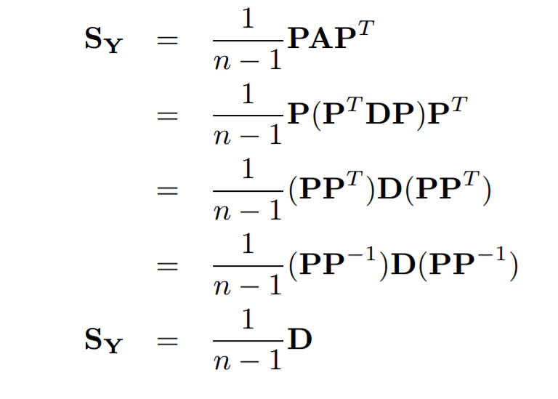
Principal Component Analysis (PCA) How to find principal component of X ? Solution 1
Find an orthonormal linear transformation P where $Y=PX$such that $S_{Y}=\frac{1}{n−1 } YY^{T}$ is diagonalized.
Choose $P=E^{T}$, meaning that each row of P is an eigenvector of $XX^{T}$
we have,

Slide 26
Principal Component Analysis (PCA) How to find principal component of X ? Solution 1 - Conclusion
Find an orthonormal linear transformation P where $Y=PX$such that $S_{Y}=\frac{1}{n−1 } YY^{T}$ is diagonalized.
Thus, if P is chosen as the eigenvector matrix of $XX^{T},$then P is the principal component of X.

Slide 27
Principal Component Analysis (PCA) How to find principal component of X ? Solution 2 - SVD
Theorem: Any arbitrary [n x m] matrix X has a single value decomposition.
Proof: [3]
Where:
V {$v_{1}, v_{2}, …r_{r}\}$is the set of orthonormal m x 1 eigenvectors of $XX^{T}$;
U {$u_{1}, u_{2}, …, u_{r}\}$is the set of orthonormal n x 1 defined by
$u_{i}=\frac{1}{σ_{i}}Xv_{i}$
$σ_{i}=\sqrt{λ_{i}}$ is singular values.

Slide 28
Principal Component Analysis (PCA) How to find U, $Σ , V$? Solution 2 - SVD
$X^{T}X={\left(UΣV^{∗}\right)}^{T}\left(UΣV^{∗}\right)=VΣU^{∗} UΣV^{∗}=VΣ^{2}V^{∗}$
$X^{T}XV=VΣ^{2}V^{∗}V=VΣ^{2}$
It has the form:
$$Xv =λv$$
solve linear equation

Slide 29
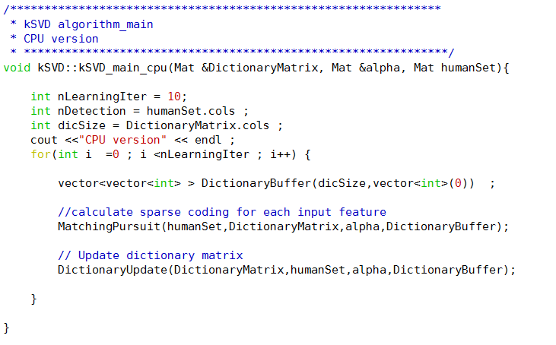
Serial implementation
Initialize
D
Sparse Coding
Use MP
Dictionary Update
Column-by-Column by SVD computation

Slide 30
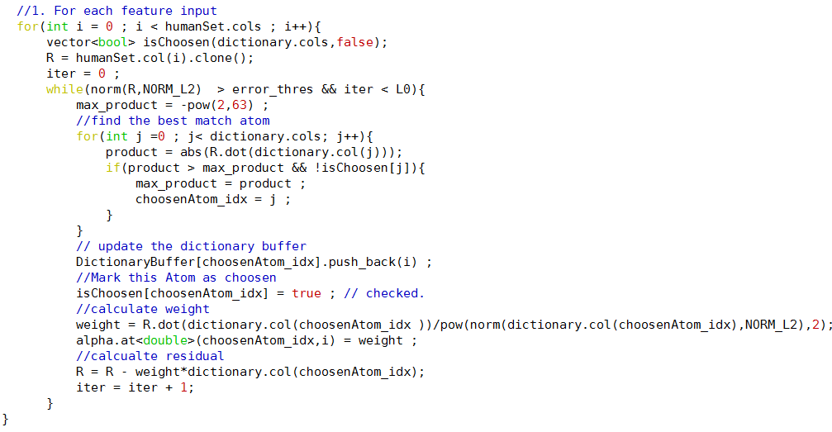
Serial implementation Matching pursuit

Slide 31
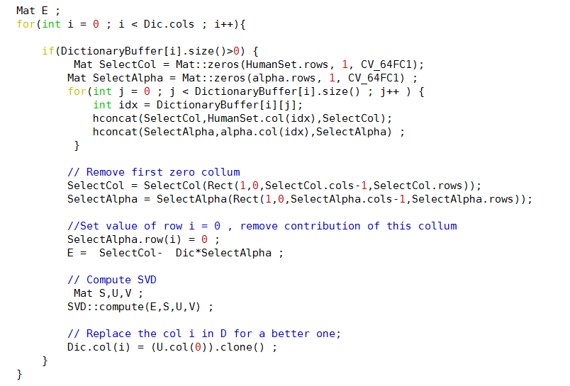
Serial implementation Learning Dictionary
Update D:
a. Remove a basis vector $d_{k}$
b. Compute the approximation error $E_{k}$ on data points
that were actually using $d_{k}$
c. Take SVD of $E_{k}$
d. Update $d_{k}$.

Slide 32
GPU implementation Matching pursuit
vector- matrix multiplication
“modified” max reduction
Inner product
sum reduction
Scalar product
subtraction

Slide 33
GPU implementation Matching pursuit –max reduction
Product <input,atom>
T0 | T1 | T2 | T3 | T4 | T5 | T6 | T7
>
>
>
>
T0 | T1 | T2 | T3
>
>
T0 | T1
>
max
T0
isChoosen[this atom index ] = true;

Slide 34
GPU implementation Matching pursuit –max reduction – data layout
Since an atom is chosen only one time
atom index
0 | 1 | 2 | 3 | 4 | 5 | 6 | 7
isChosen Array
0 | 1 | 0 | 0 | 0 | 1 | 0 | 0
Product <input,atom>
T0 | T1 | T2 | T3 | T4 | T5 | T6 | T7
>
>
>
>
T0 | T1 | T2 | T3

Slide 35
GPU implementation Matching pursuit –max reduction
Additional branch condition is needed
Whenever do swap, also swap its index and it’s isChosen value

Slide 36
GPU implementation Learning Dictionary
Divided into 2 sets:
- independent atoms
- dependence atoms
Update D:
a. Remove a basis vector $d_{k}$
b. Compute the approximation error $E_{k}$ on data points
that were actually using $d_{k}$
c. Take SVD of $E_{k}$
d. Update $d_{k}$.
Sparse matrix multiplication
Parallelized SVD

Slide 37
GPU implementation Learning Dictionary
Divided into 2 sets:
- independent atoms
- dependence atoms
Update D:
a. Remove a basis vector $d_{k}$
b. Compute the approximation error $E_{k}$ on data points
that were actually using $d_{k}$
c. Take SVD of $E_{k}$
d. Update $d_{k}$.
Sparse matrix multiplication
Parallelized SVD

Slide 38
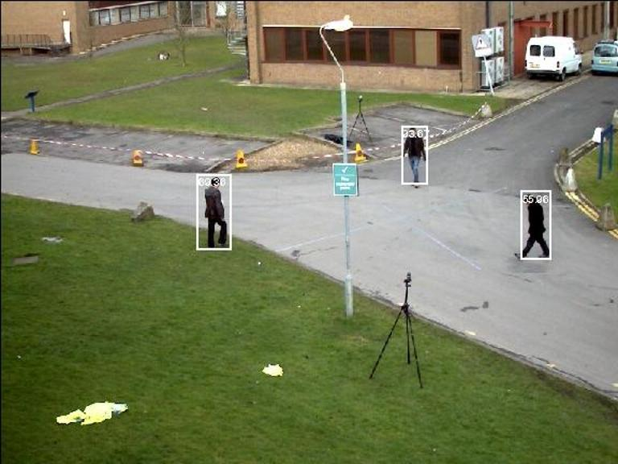
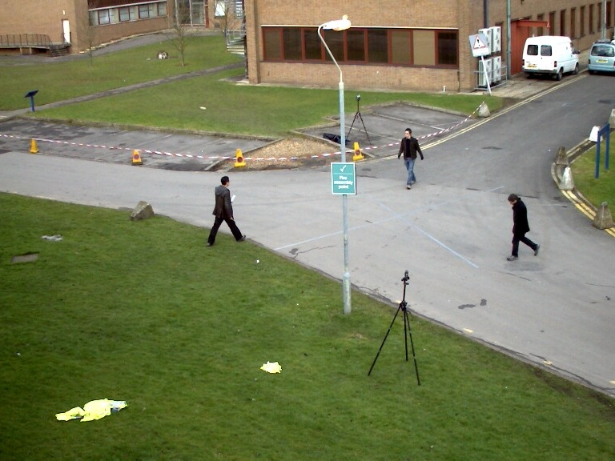
GPU implementation Dataset
PETS09-S2L1 – MOT Challenge 2015.
numTargets / frame = 4-10 persons
Number of frames: 785
Frame rate: 15fps
Frame Dimension: 768x576

Slide 39
GPU implementation Result
feature size = 512 | Sparsity 30%
nDetections | dicSize | gpu(ms) | cpu(ms) | Speed up
3 | 3 | 0 | 0 | 0
3 | 20 | 20 | 10 | 0.5
4 | 49 | 50 | 100 | 2
3 | 101 | 70 | 420 | 6
5 | 203 | 260 | 1650 | 6.34
5 | 299 | 460 | 3780 | 8.21
5 | 401 | 840 | 8580 | 10.21
6 | 500 | 1130 | 16670 | 14.75
7 | 599 | 3250 | 27870 | 8.57
6 | 700 | 3510 | 32909 | 9.37
7 | 800 | 5640 | 41100 | 7.28
6 | 900 | 7340 | 51390 | 7.00

Slide 40
What’s next ?
Getting more results/analysis (will be in report)
Finish parallelizing update dictionary
Working on independent/ dependent sets
Sparse matrix multiplication
SVD
Existing SVD parallel library for CUDA: CuBLAS, CULA
Comparing my own SVD (solving one linear equations) with function in these libraries.

Slide 41
What’s next ?
Avoid sending the whole Dictionary, Input Features to GPU every frame, but instead concatenating them.
Algorithms for Better Dictionary Quality
Fit the GPU’s memory
Still good for tracking.
Parallelizing the whole multi-target tracking system.

Slide 42
References
[1] http://mathworld.wolfram.com/EigenDecompositionTheorem.html
[2] http://stattrek.com/matrix-algebra/covariance-matrix.aspx
[3] eigenvectors and SVD
https://www.cs.ubc.ca/~murphyk/Teaching/Stat406 Spring08/Lectures/linalg1.pdf
[4] https://www.cs.princeton.edu/picasso/mats/PCA-Tutorial-Intuition_jp.pdf

